Slide 1
Tractor Gyroplanes (Autogyros)
A Presentation of virtualultralightmuseum.com

Slide 2
This presentation provides a taste of the design progression of tractor gyroplanes (engines in the front), since it’s inception in the 1930’s. Some of these aircraft have never flown. Some are just artists conceptions. Some are adaptations of earlier models. And some are currently recreational vehicles.

Slide 3
Airborne 200
Designed and built by Michael Guard. Modified Little Wing. Flies well.

Slide 4
American A-35 (1935)
Designed as a road-able craft. Based around a Pitcairn model.

Slide 5
Adelle (Russia)
Designed by V. Ustinov. Agricultural aircraft with composite body.

Slide 6
Avro 671 Rota
Introduced by RAF. A variant of the Cierva C30.a. 7 cylinder radial. 140 hp. Armstrong Siddeley. Cruise 95 mph. Rate of climb 700 ft./min.

Slide 7
Barsik (Russian)
Single piece composite frame. Early prototype.

Slide 8
Bladerunner
Artist’s conception. By designer Duncan o’Devonport from New Zealand as explained on Rotary Wing Forum in 2004. Partially built.

Slide 9
Chkalmid
Under construction in Russia.

Slide 10
Ciervo C-4 (1923)
Very early Cierva model designed by Juan de Cierva. Four bladed rotor. Built from Sommer monoplane. 110 hp. Single-seat.

Slide 11
Ciervo C.30 (1933)
Designed by Juan de la Cierva as a three blade rotor model with a radial engine. Spanish-built Cierva C-30 3/4- scale replica flew successfully with some engine troubles.

Slide 12
CL-20 (1934)
Westland-Lepere from Britain. 90 hp engine. Empty weight 840 lbs. 2-seater.

Slide 13
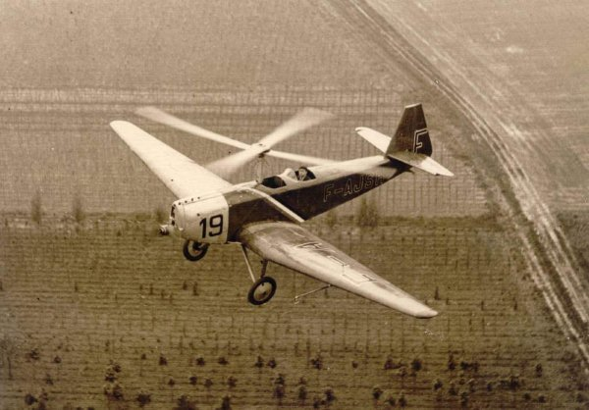
Clignogyro (1931)
Odier-Bessieres has fixed wing and autogyro characteristics. Take-off in 20 yards. 2-seater.

Slide 14
Deere Tractor
Never completed.

Slide 15
Doyle Tractor
No info available.

Slide 16
Eger (Russian)
Another design by Valentin Ustinov.

Slide 17
Eich JE-2 (1977)
Two place. 65hp Continental A-65. Plans marketed to home-builders. Flown successfully.

Slide 18
Farmer
Russian. No info available.

Slide 19
Flettner Fi 184 (1936)
Designed by Anton Flettner with a three bladed, torqueless rotor. Single- seat version. Crashed on test flight.

Slide 20
Fred Tractor
No info available.

Slide 21
Girhel (1959)
Designed by Ing. Georges Lepere. Lift b fixed wings. Two-seater. All metal fuselage. 90 hp. Engine. Prototype. May not have flown.

Slide 22
George Pate
Never flown.

Slide 23
Gyroptere (1927)
Designed by Lucien Chauviere, a propeller designer. 170kW Renault engine.

Slide 24
Hafner AR-III Mk2 (1937)
British advancement over La Cierva. 84 hp. engine. Empty weight 640 lb.

Slide 25
Harry Albert
Mini-plane modified by Virgil Jones. Used a McCulloch J-2 rotor head with modified Dragon Wings blades. It never flew.

Slide 26
Ikenga Cygnus 21 (1989)
David Gittens designer. Early prototype. Flew well.

Slide 27
Ikenga Cygnus 21T
David Gittens designer.

Slide 28
Ikenga 530Z (1988)
David Gittens designer.

Slide 29
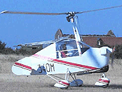
JT-9
Designed by Jukka Tervamaki from Finland. Good performance with low power.

Slide 30
Jungle Gym
Designed by Joe Terminella using Little Wing plans as guide. It was successfully flown but was underpowered.

Slide 31
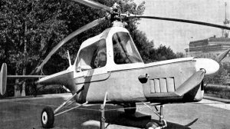
KAI-24
Russian. Two-seat tandem built at Kharkov Aviation Institute in late 1960’s. 115 hp. engine.

Slide 32
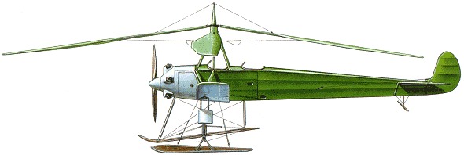
KASKR-2 (1930-31)
First Russian auto-gyro. Designed by N.I. Kamov and N.K. Skrzhinskij. Flown more than 90 times.

Slide 33
Kay Gyro 33/1 (1935)
Designed by David Kay. A gyroplane with collective pitch control. 75 hp. engine. Empty weight 838 lbs. Single-seat.

Slide 34
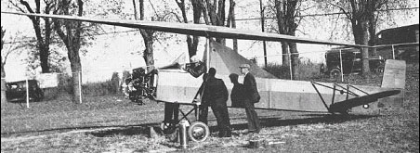
Kellett K-1
Kellett’s first autogyro. Never flown.

Slide 35
Kriek
From S. Africa. A Wagtail Aviation design.

Slide 36
Little Wing
Little Wing by Ron Herron. Flies well.

Slide 37
Ninja
No info available.

Slide 38
Oskbes Mai-208
2 seat crop duster and trainer by A. Zorin, designer

Slide 39
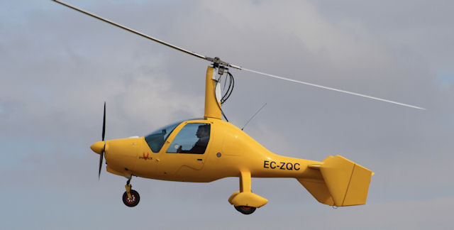
Phenix (Spain)
First demonstrated in 2009. Production autogyro.

Slide 40
Pitbull
The PitBull by John Van Vorhees. It has flown quite successfully

Slide 41
Whirlwing. (1939)
Pitcairn/Larsen PA-36. All metal. 165 hp. engine. Direct-control rotor. 2-seater.

Slide 42
Popular Mechanics
In Popular Mechanics. Chiropractors Gustafson/Stober from Portland, OR.

Slide 43
Raven
Designed by Jeron Smith. Never flown

Slide 44
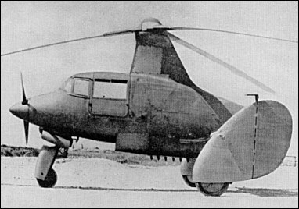
SE-700
SNCASE Is a three-seater. Jump take-off. 28-137 mph.

Slide 45
Springkaan
S. African. First flew in 2003

Slide 46
Stauffer
Rotor also a wing.

Slide 47
Tractor Chel
From France.

Slide 48
TsAGI A4 (1932)
Russian. 2-seater. Designed by
V.A. Kuznetsov as a military trainer. Short takeoff. Speed range 26 mph – 106 mph.

Slide 49
Unknown
No info available.

Slide 50
Velocity
Future concept by Sport Copter.

Slide 51
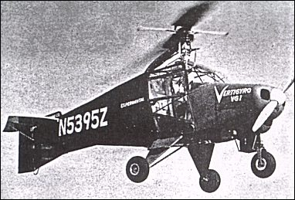
Vertigyro VG-1 (1963)
Designed by Bruno Nagler. A Piper Colt fuselage. Compressed air rotor allows for vertical take-off. 2-seater. Combination helicopter/gyroplane.

Slide 52
Vuitton
Late 1800s. Never flew.

Slide 53
Weir W-2 (Brit., 1934)
James Weir design. Minimal performance with 50 hp. engine. Jump take-off. Single-seat.

Slide 54
Weir W-3 (1936)
Jump start takeoff vehicle. Adjustable pitch rotor. 50 hp. 650 lbs. fully loaded. Single-seat.

Slide 55
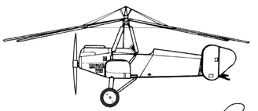
Weymann CTW 201 (1930)
Built by Weymann. Four-bladed rotor that tilted forward. 19-93 mph. 2-seater.

Slide 56
Wigal (1963)
Designed by Voorhis F. Wigal. Motor tilts to enable hovering and takeoff. 15-60 mph. Single-seat.

Slide 57
Wilford WRK
Designed by E. Burke Wilford

Slide 58
THE END
Brought to you as a courtesy from
virtualultralightmuseum.com. Any further information on the aircraft would be appreciated.
Contact:
Jerry M. Goffman, Curator
jerrygoffman@hotmail.com

